Slide 1


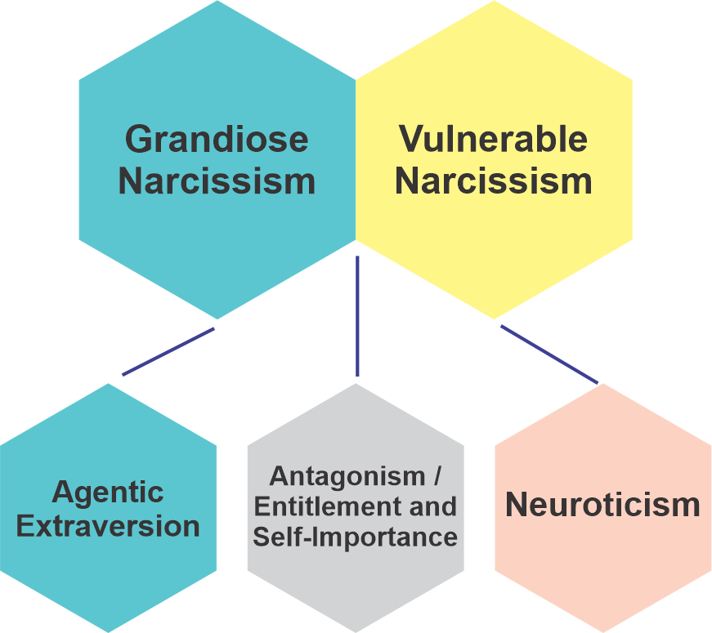
SENSITIZING INTERNATIONAL MEDICAL GRADUATES TO IDENTIFY
NARCISSIST PERSONALIY DISORDER
Dr. Humaira Shamim
MBBS;FCPS (Derm), CHPE
CONSULTANT DERMOTOLOGIST, LAHORE, PAKISTAN
Email: dr.homaira@gmail.com
INTRODUCTION
DISCUSSION
Developmental Factors in etiology of narcissistic personality disorder
Parenting Styles | Parental Overvaluation Invalidation
Childhood Adversity | Child abuse
Parental Hostility | Parental Neglect
Attachment Styles | Dismissive, Avoidant
Other Factors | Not possible to classify
Narcissistic personality disorder is a complex personality disorder that was first conceptualized by Sigmund Freud in 1914.
Narcissistic personality disorder is characterized by a persistent sense of self-importance, grandiosity, and admiration of oneself.
In narcissistic personality disorder, a series of defense mechanisms are employed unconsciously including repression, and consciously including denial, distortion, rationalization, lies, manipulative, lack of respect, reacting negatively to criticism, psychological projection and codependency. Prevalence of narcissistic personality disorder is 6.2 percent with greater prevalence rate for men ( 7.7%) as compared to women ( 4.8%)
Empathy that is affected has its roots in the subcortical region of the brain, while cognitive empathy is associated with a network of cortical regions that facilitate processes related to mind reading.
REFERENCES
1. Stinson FS, Dawson DA, Goldstein RB, Chou SP, Huang B, Smith SM, Ruan WJ, Pulay AJ, Saha TD, Pickering RP, Grant BF. Prevalence, correlates, disability, and comorbidity of DSM-IV narcissistic personality disorder: results from the wave 2 national epidemiologic survey on alcohol and related conditions. J Clin Psychiatry. 2008 Jul;69(7):1033-45. doi: 10.4088/jcp.v69n0701.
2. Weinberg I, Ronningstam E. Narcissistic Personality Disorder: Progress in Understanding and Treatment. Focus (Am Psychiatr Publ). 2022 Oct;20(4):368-377. doi: 10.1176/appi.focus.20220052.
3. Schalkwijk F, Luyten P, Ingenhoven T, Dekker J. Narcissistic Personality Disorder: Are Psychodynamic Theories and the Alternative DSM-5 Model for Personality Disorders Finally Going to Meet? Front Psychol. 2021 Jul 15;12:676733. doi: 10.3389/fpsyg.2021.676733.
4. Bilotta E, Carcione A, Fera T, Moroni F, Nicolò G, Pedone R, Pellecchia G, Semerari A, Colle L. Symptom severity and mindreading in narcissistic personality disorder. PLoS One. 2018 Aug 15;13(8):e0201216. doi: 10.1371/journal.pone.0201216.
5. Silove D, Manicavasagar V, Pini S. Can separation anxiety disorder escape its attachment to childhood? World Psychiatry. 2016 Jun;15(2):113-5. doi: 10.1002/wps.20336.
CONCLUSION
The narcissist has self-praise, and arrogance, and is self-centered with no empathy. International medical graduates should learn to identify this personality trait and develop boundaries to protect themselves. This personality is prevalent everywhere in workplaces. Protect yourself by identifying them and ignoring them by setting boundaries with such professional colleagues.
Figure 1. Structural model of narcissism, adapted and synthesized from the Trifurcated Model (Miller et al., 2016; Weiss et al., 2019) and the Narcissism Spectrum Model (Krizan & Herlache, 2018).
ACKNOWLEDGEMENT
This poster is supported by CIBNP

